Slide 1
Aristotle Dr. Stephanie Spoto sspoto@mpc.edu Monterey Peninsula College
Gentrain
1 November 2018

Slide 3
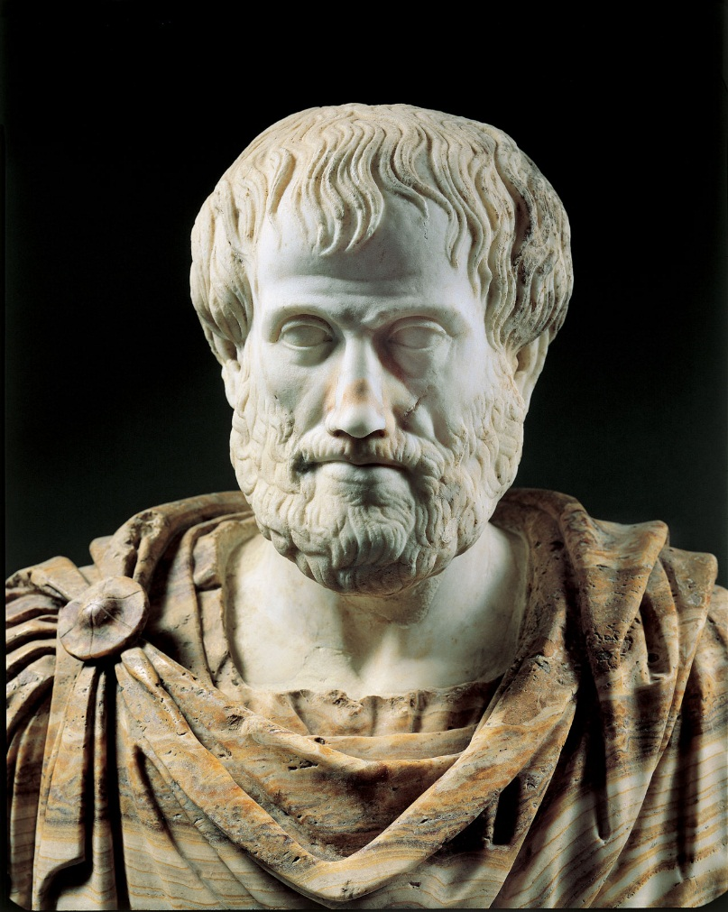
Aristotle
Born 384 BCE in Thrace (modern day western Turkey)
Age 18, moved to Athens, student of Plato, until Plato’s death in 348. Traveled & married
Became tutor of Alexander in 343 (Alexander was 13) until he came of age (age 16)
Lived in Athens 335-323, founded his school and wrote
When Alexander died, there was political turmoil → Aristotle indicted for impiety, but fled to avoid punishment.
Died the next year, 322 BCE.
Aristotle, marble portrait bust, Roman copy (2nd century BC) of a Greek original (c. 325 BC); in the Museo Nazionale Romano, Rome.

Slide 4
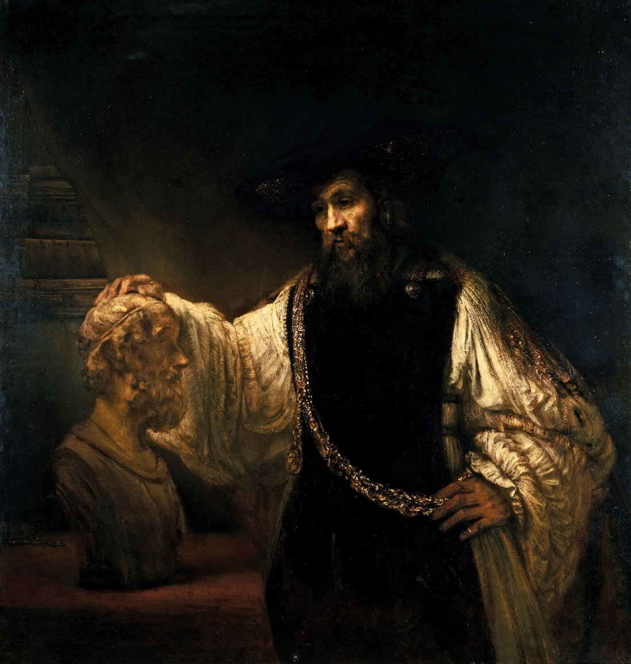
Scientific contributions
Created system of logic that included species classification by genus and difference
Geological observations: the earth is not status → lakes dry up and fill with water, land might become sea, etc.
Noted that most changes to the earth happen on timescales too vast to be witnessed or understood by humans
Aristotle Contemplating the Bust of Homer, oil on canvas by Rembrandt van Rijn, 1653; in the collection of the Metropolitan Museum of Art, New York.

Slide 5
Geological change and time
The same parts of the earth are not always moist or dry, but they change according as rivers come into existence and dry up. And so the relation of land to sea changes too and a place does not always remain land or sea throughout all time, but where there was dry land there comes to be sea, and where there is now sea, there one day comes to be dry land. But we must suppose these changes to follow some order and cycle. The principle and cause of these changes is that the interior of the earth grows and decays, like the bodies of plants and animals. . . .
But the whole vital process of the earth takes place so gradually and in periods of time which are so immense compared with the length of our life, that these changes are not observed, and before their course can be recorded from beginning to end whole nations perish and are destroyed.
Meteorology, 1.14

Slide 6
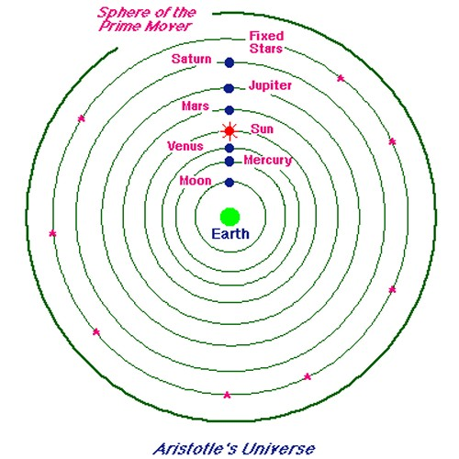
Aristotle’s solar system
Earth the fixed center of the universe
Fifty-five solid spheres – earth as common center
Each sphere had a planet or other celestial body → propelled by inner principle of motion (a god)
Each motion affected all other motions → originally set in motion by the Unmoved Mover
Lower levels (heavy elements) were changing and imperfect – but the heavenly sphere (above the moon) were perfect

Slide 7
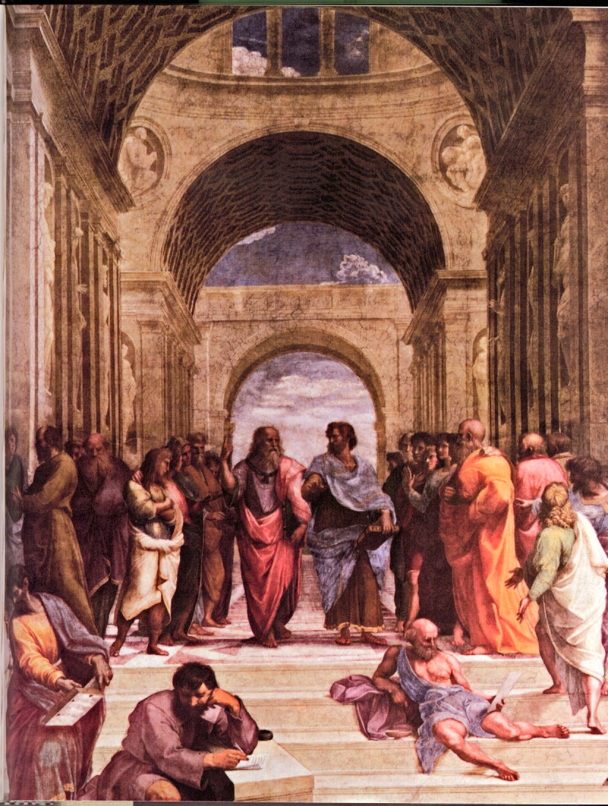
Plato, Aristotle, Matter, and Form
Atomists affirmed objective order of material sensory world → neglected inner world of mind
Plato argued for the order of reason, and left the matter in a dubious state. → Failed to show how two worlds could participate in each other
Aristotle tried to show that material and rational world were real and related.

Slide 8
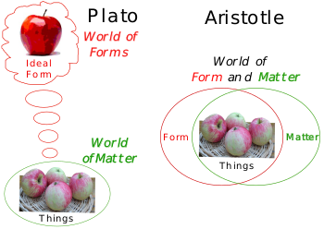
Plato, Aristotle, Matter, and Form
Plato: Forms were eternally real things
Separate in reality from temporal things that were mere shadows or copies
Aristotle: Forms aspects of material things → mind can distinguish form as aspects of reality but not as separate from things
Not denial of forms, but of their separateness from matter and things

Slide 9
Aristotle’s matter and form
Individual objects both matter and form
Matter: own individual concreteness; potentiality, possibility
Form: shared in common with other substances; actuality
Each thing was realized/actualized form of lower/earlier matter-potential
Every form might be matter for some higher form

Slide 10
Aristotle’s psyche and the soul
Distinguished between what had life and what did not
Life possessed a psyche (soul)
Not distinguishable from form → inner power which guided becoming/actuality
Natural, inseparable, continuous with concrete individual → not alien resident
“. . . the soul neither exists without a body nor is a body of some sort. For it is not a body, but it belongs to a body, and for this reason is present in a body, and in a body of such-and-such a sort” (de Anima, 414a20ff).

Slide 11
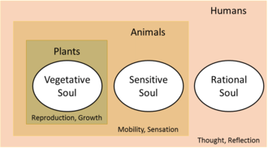
Three kinds of soul
Nutritive/vegetative soul: possessed by all living forms
Directed the processes that built matter brought into the body into form/shape
Sensory/Appetitive/Sensitive soul: animals, people
Perception of particles, sense organs → not all living things reacted to particles
Rational: people, perhaps higher animals
Activity of thought → required lower kinds of soul → no knowledge without sensation because mind and matter were inseparable except in the mind of God

Slide 12
Three souls and unity of matter/form
Knowledge through sensory perception: There is a continuity between concrete material and soul
Unity of reality not lost or destroyed in process of knowledge → reality between:
The material object
The sensory form of the object received from the sense organ
The intelligible form received in the mind from the sensory form
Not Cartesian:
No inner/outer difference or contrast → not inner spectator having to infer existence of material world through sense perception
Not separate existence, but form of body itself → not substance (soul) inside other substance (body)
Not related to personality

Slide 13
Next week Week 11 (Tues Nov 6): 8:45-9:50, Plato and Aristotle on Art
Question to consider:
Given Plato and Aristotle’s different philosophies of form and matter, what might you think their understanding of artistic representation might be?

